Slide 1



Predicting Tissue-Specific Gene Expression from Blood Using AI
Presented by
Kartika Waluyo, 1000555
Vrinda Rajendar Rajanahally, 1129446
Supervised by
Roberto Bonelli PhD, CSL Research
Brendan Ansell PhD, WEHI
Prof Melanie Bahlo, WEHI
Monther Alhamdoosh PhD, CSL Research
Ziad Al Bkhetan PhD, The University of Melbourne
Prof Michael Kirley, The University of Melbourne
25 June 2021

Slide 2
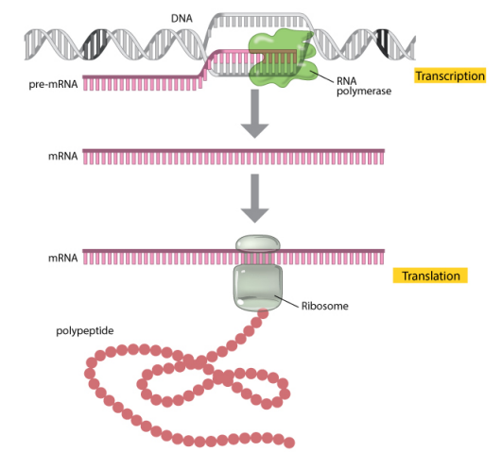
Introduction
Gene expression
Measured through RNA sequencing
Indicates the “activation level” of genes in a tissue
Widely used in medical research to understand disease mechanisms and assess the effectiveness and safety of treatments
protein
Image source: https://www.nature.com/

Slide 3

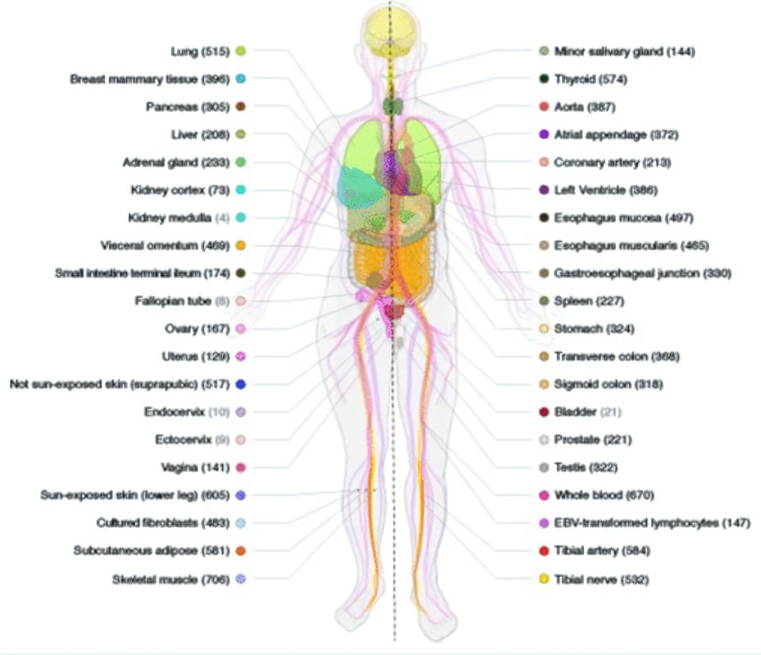
Data
The Genotype-Tissue Expression (GTEx)
Publicly available dataset containing gene expression of 54 post-mortem tissues from almost 1,000 individuals
Website: https://www.gtexportal.org/home/
Image source: https://www.researchgate.net/figure/Sample-and-data-types-in-the-GTEx-v8-study-A-Illustration-of-the-54-tissue-types_fig1_336246636
Notes:
The Genotype-Tissue Expression (GTEx) project is an ongoing effort to build a comprehensive public resource to study tissue-specific gene expression and regulation. Samples were collected from 54 non-diseased tissue sites across nearly 1000 individuals,

Slide 4
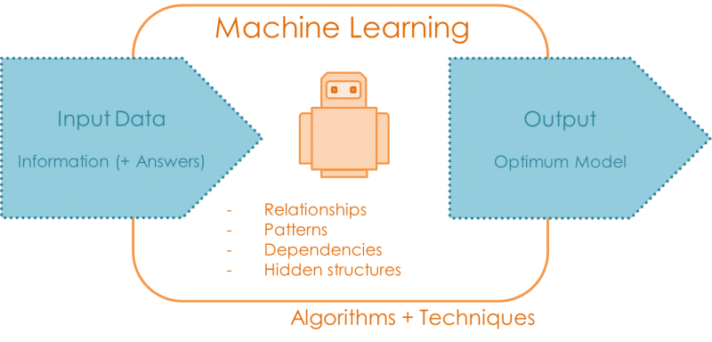
Problem
Gene expression varies across tissues
Obtaining samples from heart, lung, brain and other organs is often not possible
Goal
Whole blood gene expression
Al
Tissue X gene expression
Algorithms + techniques
Image source: https://quantdare.com/
Notes:
To assess new treatments corresponding to certain tissues, need to understand the gene expression of said tissues
Goal: Development of a machine learning algorithm that can reliably predict gene expression in many different tissues when only gene expression measurements in whole blood are available

Slide 5


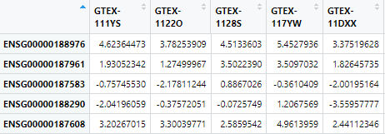
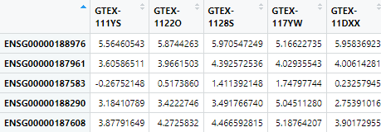

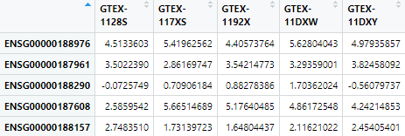
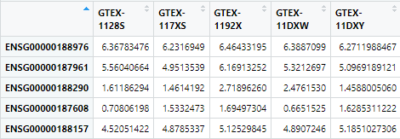
Data Preprocessing
Notes:
Explain: For each tissue, keep the shared genes and shared donors with blood only
Justification?

Slide 6
Preliminary Data Analysis
Exploration of similarities between each tissue and whole blood
Shared expressed genes
Shared donors
Gene expression correlation

Slide 7
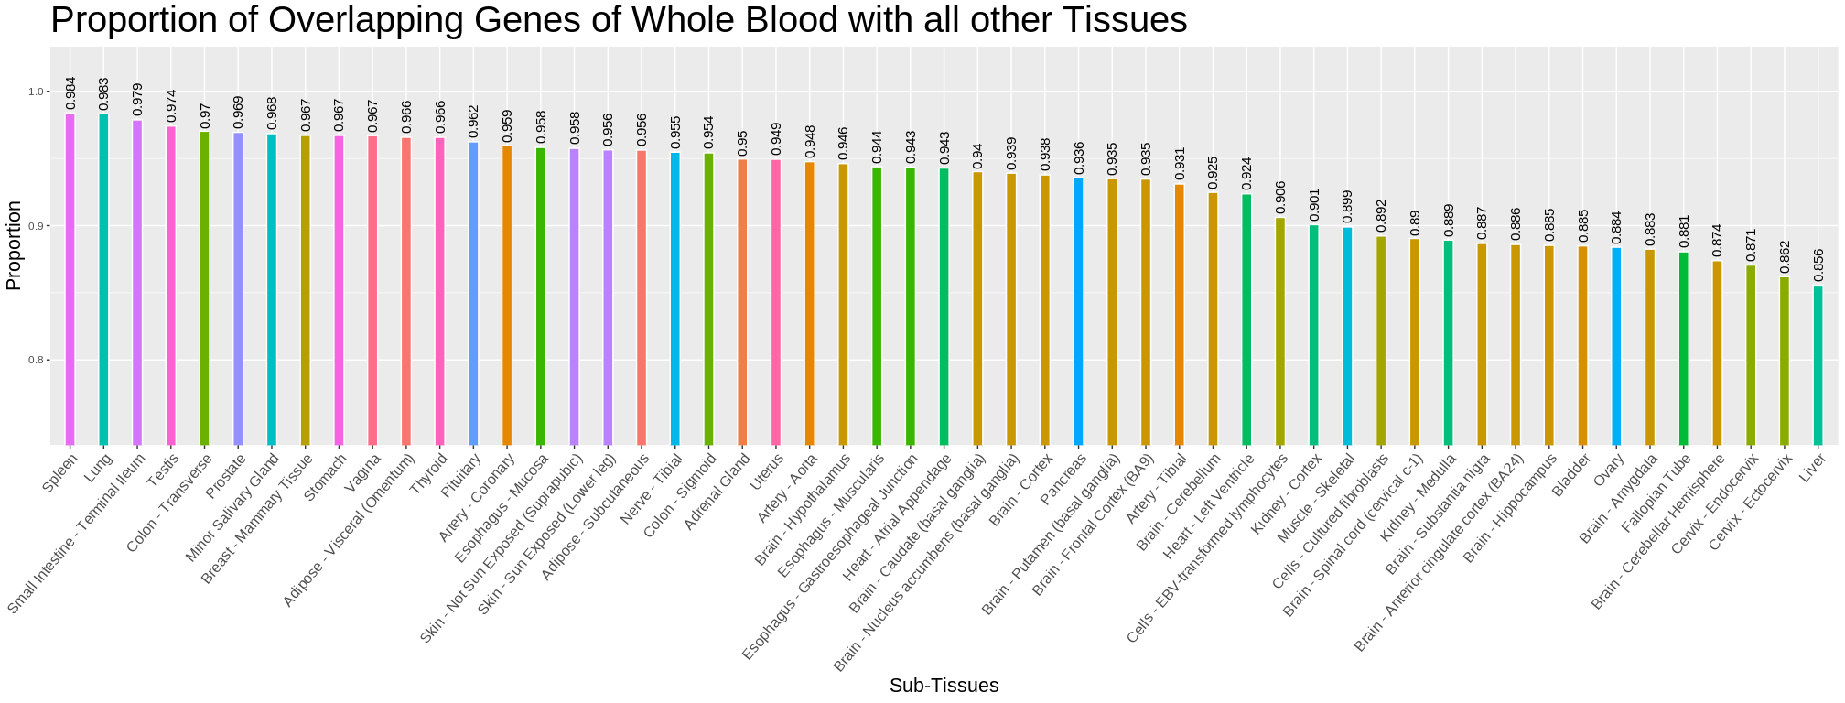

Slide 8
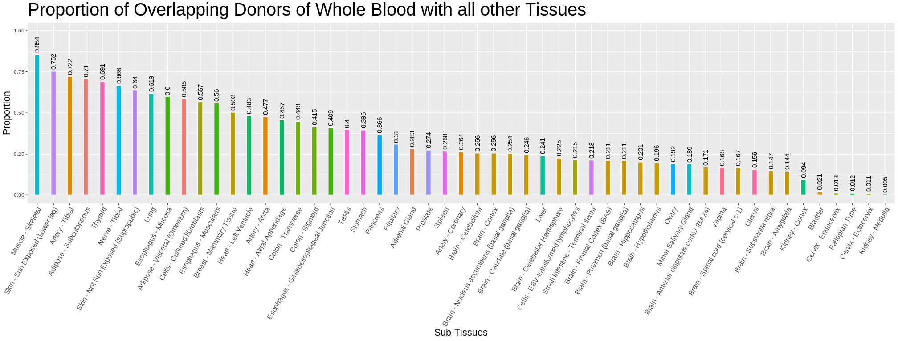

Slide 9
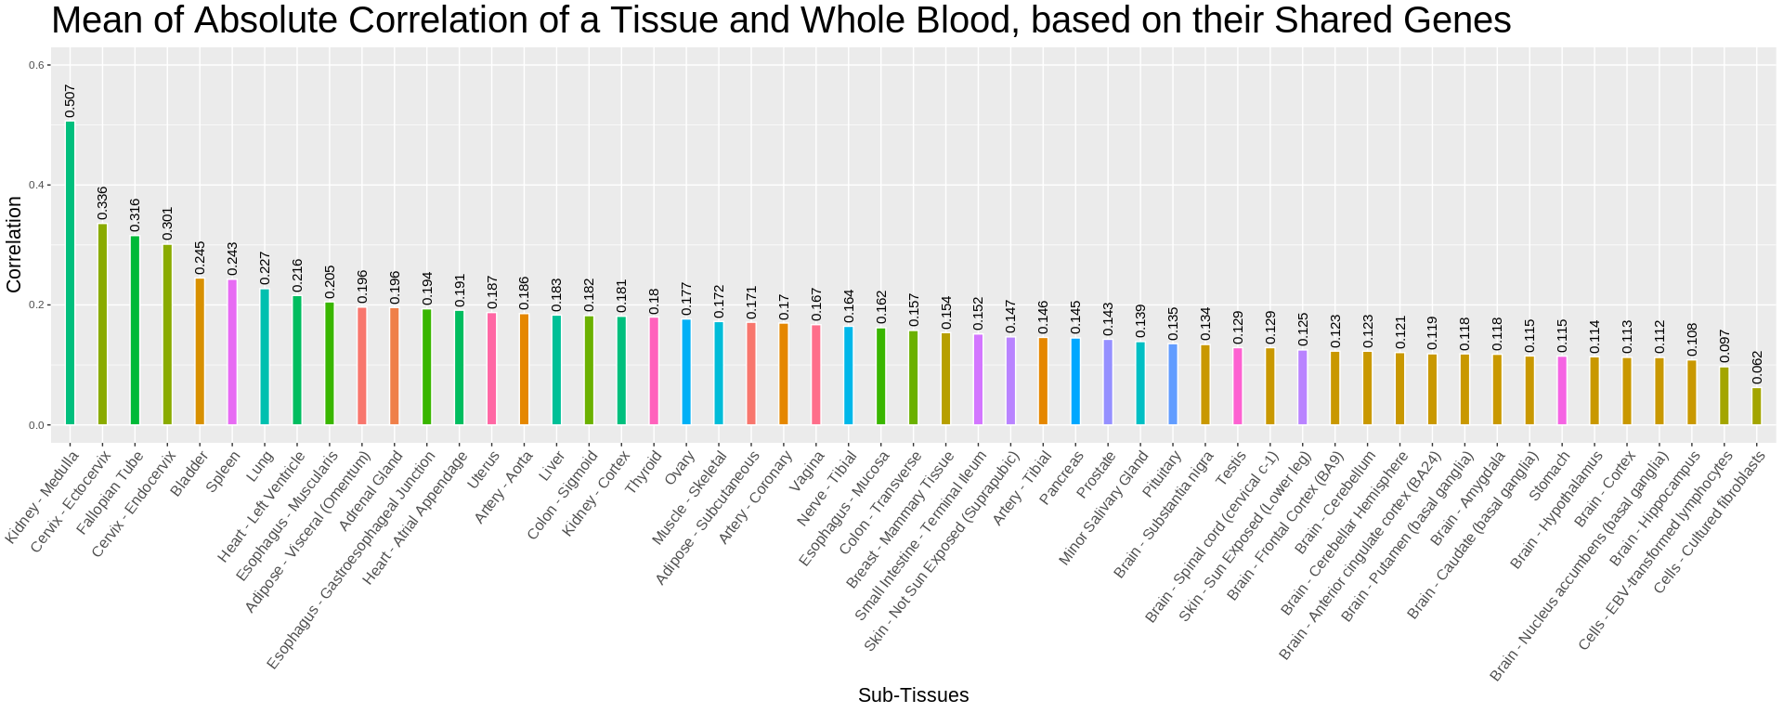
Pairwise correlation between each gene in whole blood's gene expressions with the same gene in other tissues' gene expressions.

Slide 10
Tissue Selection
Rank tissued based on the previously observed measures
Notes:
Lung has the lowest rank
Meaning: most similar to blood in terms of shared donor, shared genes and correlation
Skin-not sun exposed
Low correlation with blood
Nerve-tibial
?? Not sure why
Mention that from here we only work with lung

Slide 11

Cross-validation
80%
Test data
20%
374 samples
93 samples
93 samples
Finding Parameters
Test data
Image source: https://scikit-learn.org/stable/modules/cross_validation.html
Notes:
Split the data into training and test set 80:20
Split the training data into 5 folds
Train the models using training data
For hyperparameter tuning , do 5-fold CV
Maybe explain about: 1st iteration use Fold1 as test set and Fold2-5 as training set, 2nd iteration use Fold2 as test set and Fold1,3-5 as training set, and so on
Take the average evaluation measure from 5 iterations
Choose the best hyperparameter combination
Train all the training set using the best hyperparameter value
Test using test set

Slide 12
Models
eXtreme Gradient Boosting
Neural Network
Ensemble Model

Slide 13
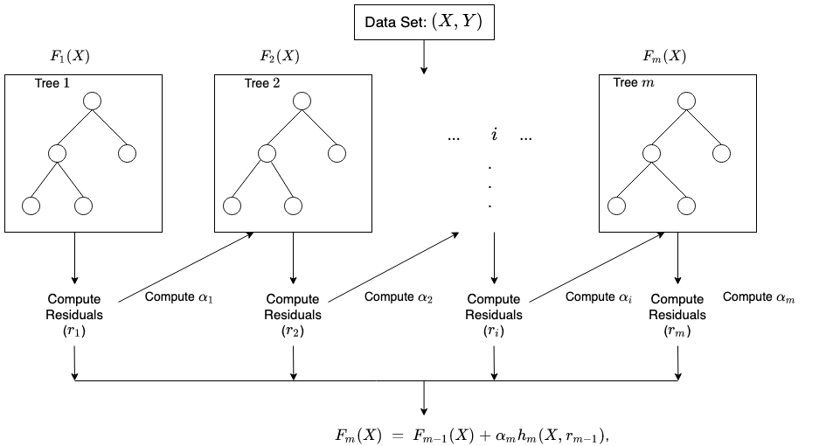
eXtreme Gradient Boosting (XGBoost)
Maximum Depth
Gamma: minimum loss reduction required to make a further partition on a leaf node of the tree.
m = number of rounds
Image source: https://docs.aws.amazon.com/sagemaker/latest/dg/xgboost-HowItWorks.html
Notes:
Boosting is an ensemble technique where new models are added to correct the errors made by existing models. Models are added sequentially until no further improvements can be made. The trees are built sequentially such that each subsequent tree aims to reduce the errors of the previous tree. Each tree learns from its predecessors and updates the residual errors. Hence, the tree that grows next in the sequence will learn from an updated version of the residuals.
It's called gradient boosting because it uses a gradient descent algorithm to minimize the loss when adding new models.
Mention : 1 model for 1 gene bcs the model doesn’t accept multivariate output
So input: the whole gene matrix from blood
Output: 1 gene from lung

Slide 14
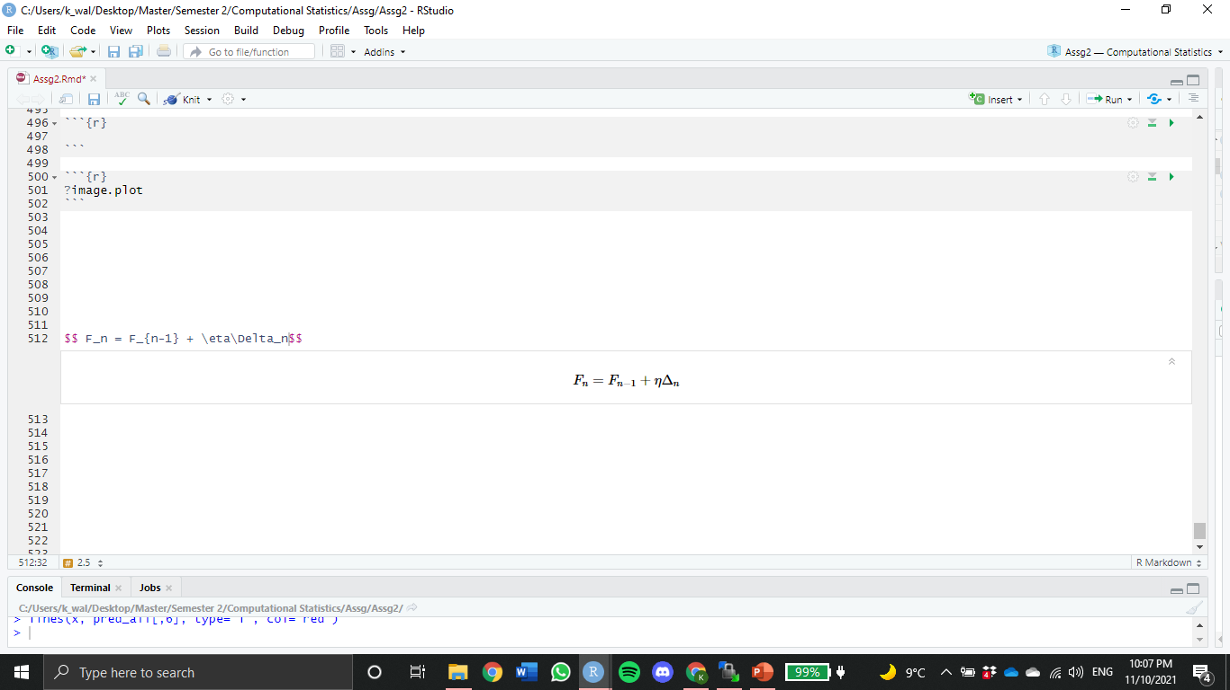
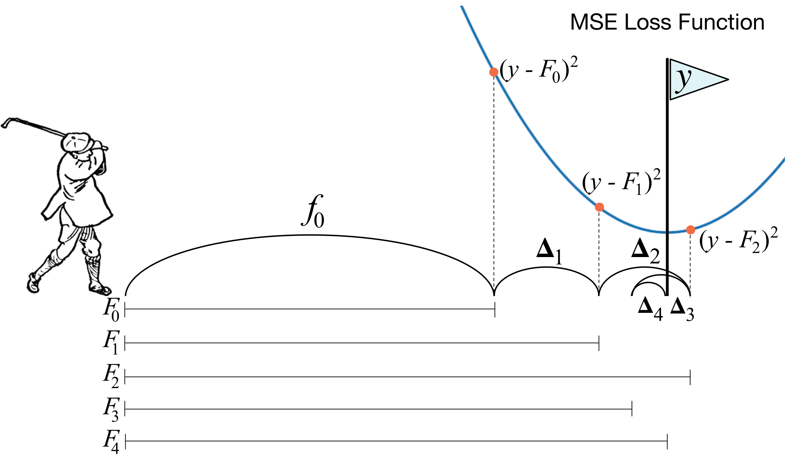
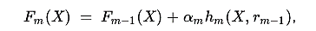
Gradient Boosting Machines (GBM)
Gradient Boosting approach is given by
Recall from previous slide
eta
residual
Image source: https://explained.ai/gradient-boosting/descent.html
Notes:
Gradient Boosting Machines (GBM)
Consider η=1, at each stage, GBM predicts the y - Fₙ₋₁ (residual or gradient of loss) which is difference of distance from pole to the golf ball
So, at every iteration, GBM tries to predict this distance, which is like golfer aiming for pole before each shot. And sometimes the ball can even cross the pole (like Δ₂), hence using the gradient descent, correct sign is applied when Δ is calculated.
So its recommended to use smaller η, such that the minima of loss or the pole isn’t missed.

Slide 15
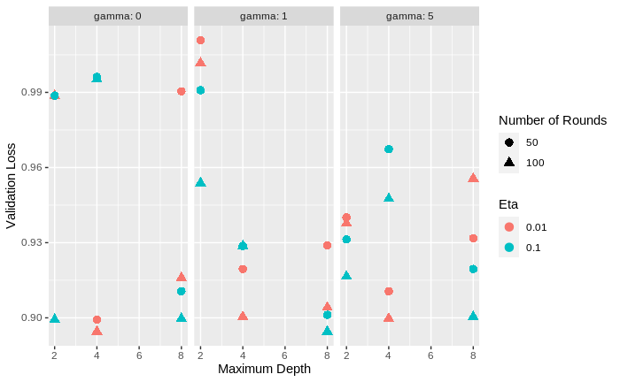
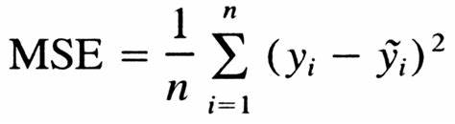
Hyperparameter Tuning
On 50 random genes
On gamma, maximum depth, eta, and number of rounds
Loss Function
Best hyperparameter combination: gamma=1, maximum depth=8, eta=0.1, and number of rounds=100
Notes:
Explain briefly how long the grid search took and the fact that only 50 random genes were used.
Explain that after the best performance parameter were chosen, the model was trained again on all genes
Loss Function: The role of the loss function is to estimate how best is the model in making predictions with the given data.

Slide 16
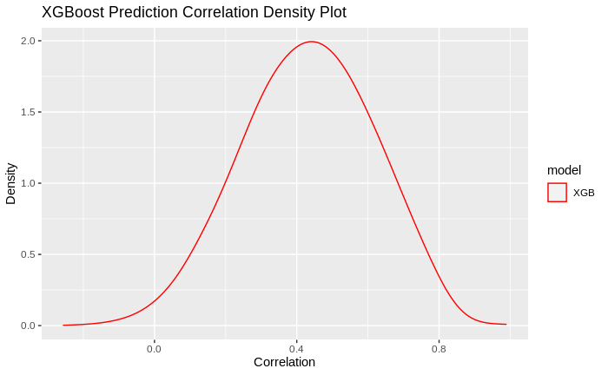
Evaluation
Compute the correlation between each gene in the prediction and its true (observed) value
Model | Median Correlation
Model | Training | Test
XGBoost | 0.990975 | 0.4364047
Neural Network
Ensemble
Notes:
Plot: density plot of the correlation from ensemble prediction
High density for positive correlation
Read for Basu et al how much was their reached correlation and compare to our results (this will be super important for the report as well)

Slide 17
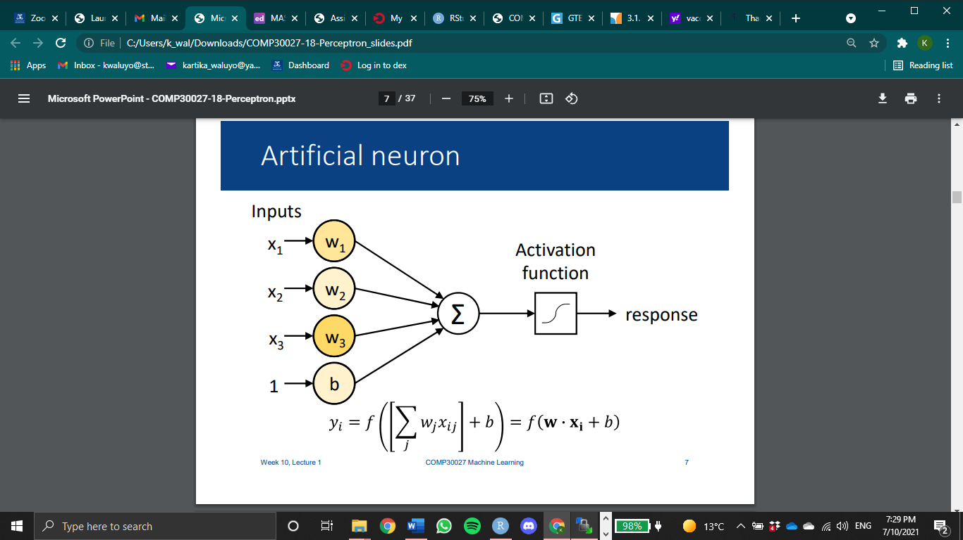
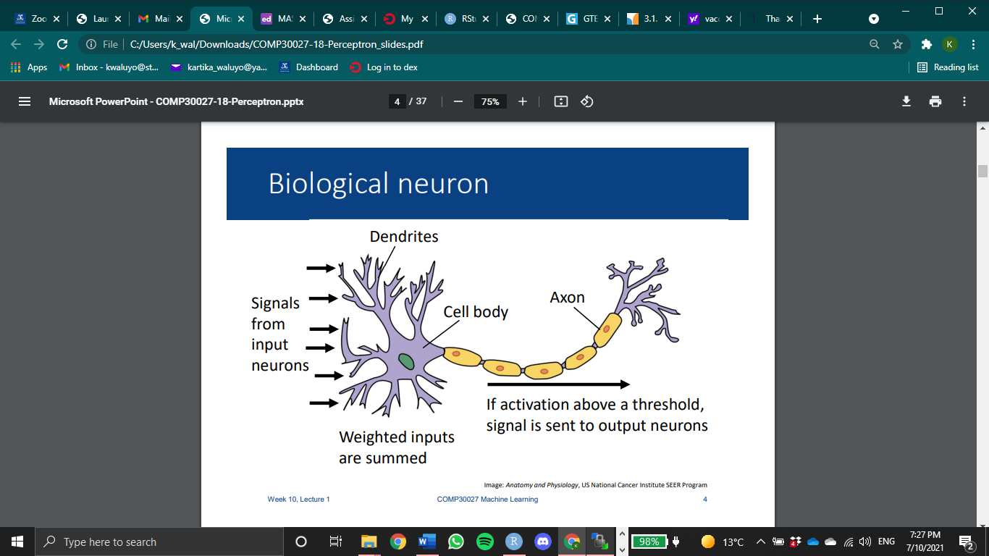
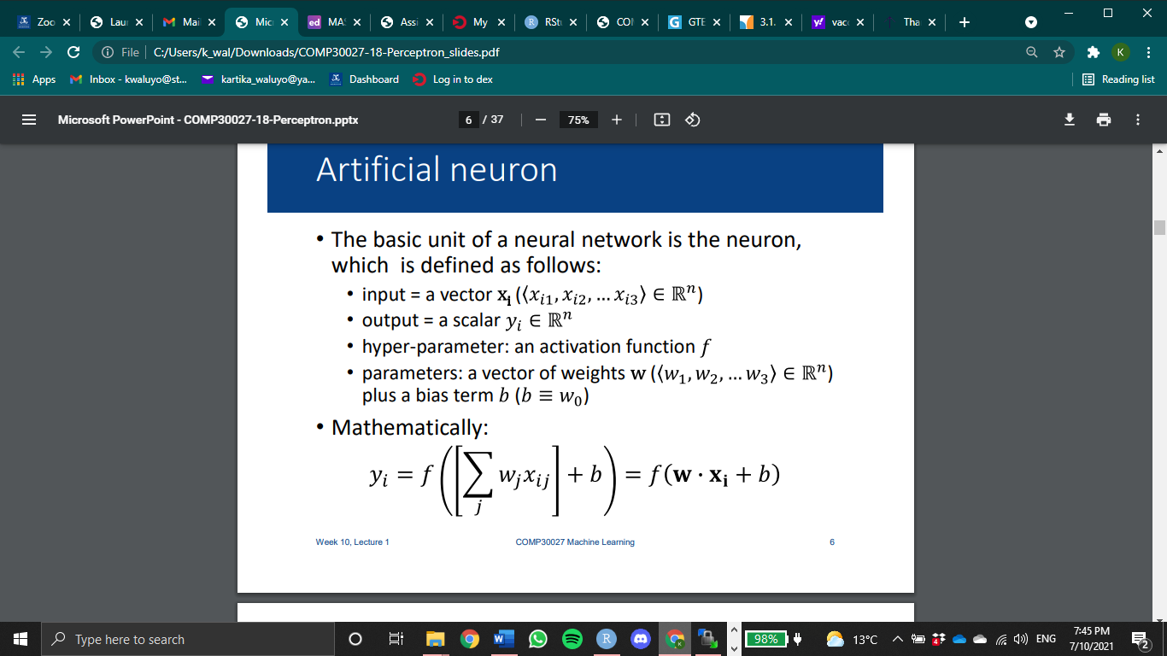
Neural Network
Biological Neuron
Artificial Neuron
Image Source: Anatomy and Physiology, US National Cancer Institute SEER Program
Notes:
Training a NN entails finding the weights which minimize errors on the training data
The classic way to train a NN is by iterating over examples in a training dataset
Each iteration over the whole dataset is called an epoch

Slide 18
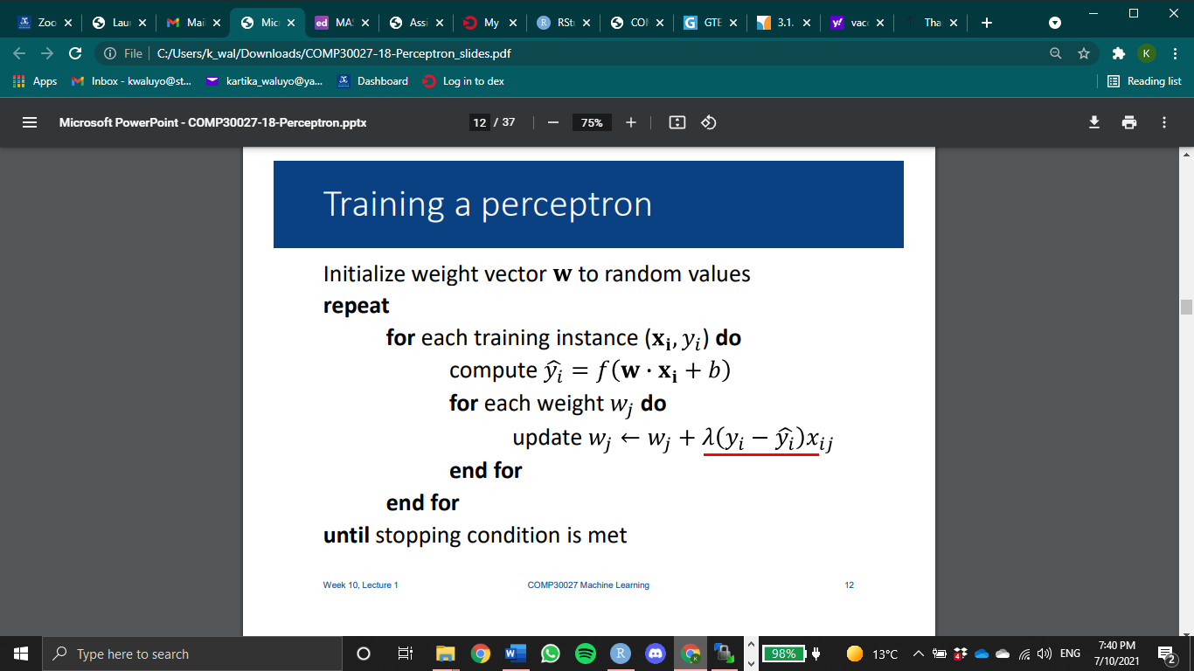
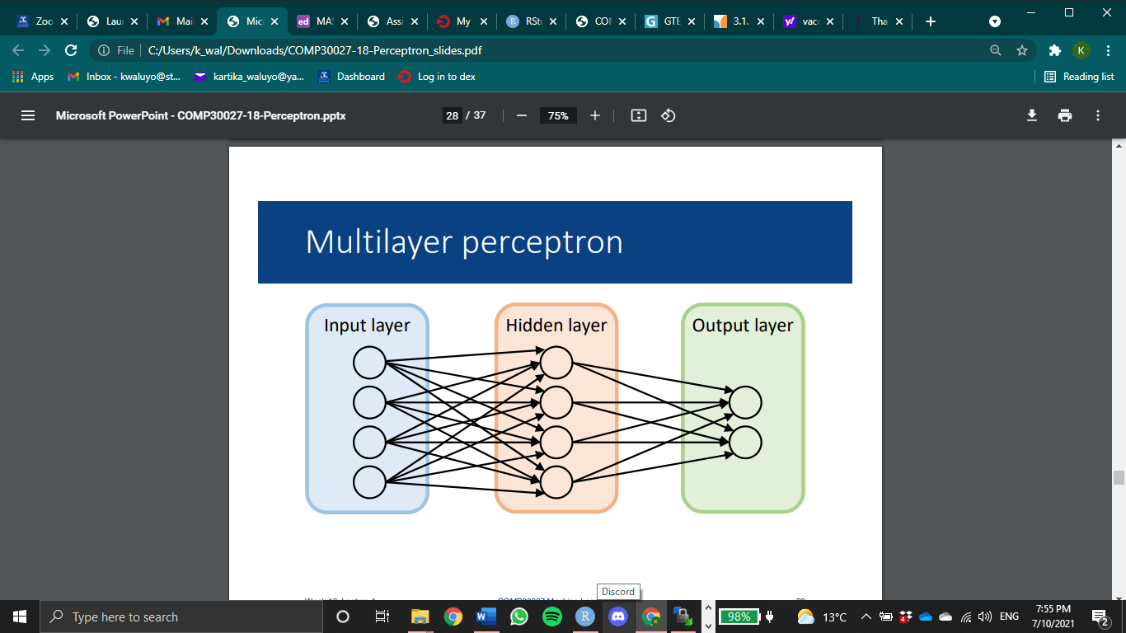
Algorithm
1 epoch
Backpropagation/gradient descent
Learning rate
High → big jump on the update
Notes:
Algorithm:
• For training examples, compute y based on current weights
• Update weights based on the difference between predicted y and true label
However,
Need to find correct weights for the output neuron(s), and all the neurons in the hidden layer
Can’t use the algorithm in the hidden layer – we don’t know what values these neurons are supposed to produce for the input
• There is no one set of “correct” values for this layer – multiple possible solutions
• Solution: backpropagation
Backpropagation:
• Form of gradient descent – iterative process for finding the weight parameters that minimize error
• Requires a learning rate → how fast we want our algo to converge
• Idea: look at the derivative of error and update weights in the direction that would reduce error
• Compute errors at the output layer w.r.t. each weight using partial differentiation
• Propagate errors back to each of the earlier layers

Slide 19
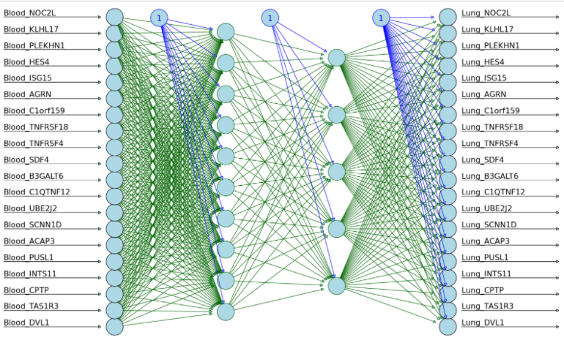
Illustration of how our neural network model might look
Input
1st hidden layer
2nd hidden layer
Output

Slide 20
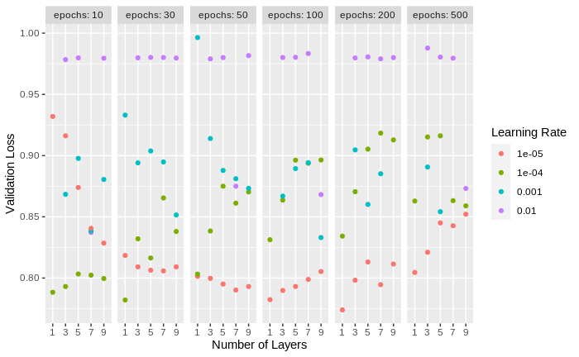
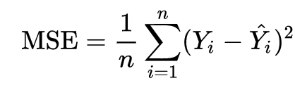
Hyperparameter Tuning
On number of layers, learning rate, and number of epochs
Loss Function
Best parameter combination:
1 hidden layer of 100 units, e⁻⁵ learning rate, and 200 epochs

Slide 21
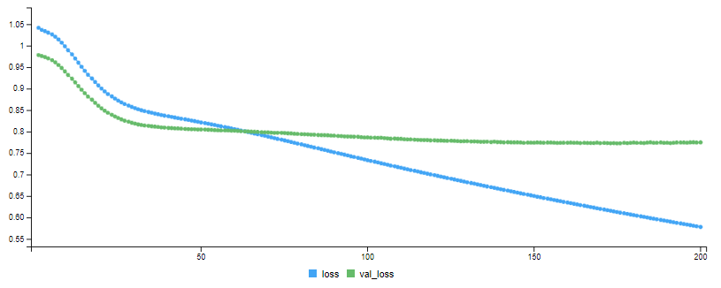
Result
Train and validation MSE, using the best model
MSE
Validation MSE

Slide 22
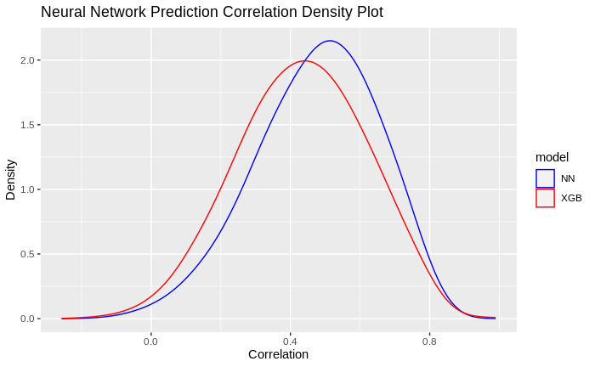
Evaluation
Compute the correlation for each gene in the prediction and the true value
Model | Median Correlation
Model | Training | Test
XGBoost | 0.990975 | 0.4364047
Neural Network | 0.6278658 | 0.4887672
Ensemble
Notes:
Plot: density plot of the correlation from ensemble prediction
High density for positive correlation
Read for Basu et al how much was their reached correlation and compare to our results (this will be super important for the report as well)

Slide 23
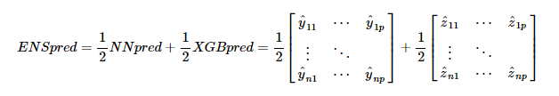
Ensemble Prediction
Notes:
The most simplistic version of the ensemble prediction possible, a model could be trained to do this better!

Slide 24
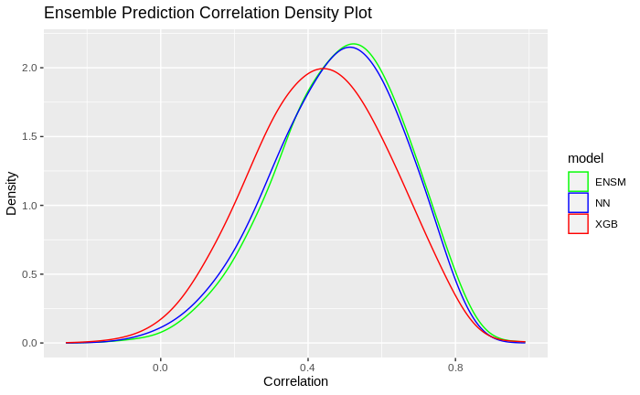
Evaluation
Compute the correlation for each gene in the prediction and the true value
Model | Median Correlation
Model | Training | Test
XGBoost | 0.990975 | 0.4364047
Neural Network | 0.6278658 | 0.4887672
Ensemble | 0.9205496 | 0.4976427
Notes:
Plot: density plot of the correlation from ensemble prediction
High density for positive correlation
Read for Basu et al how much was their reached correlation and compare to our results (this will be super important for the report as well)

Slide 25
Future Directions
Create model and tune hyperparameter for all tissues
Use all genes from both tissues
Use another ML model for the ensemble instead of only taking the average prediction
Notes:
Mention that the previous results are only for lung

Slide 26

We would like to extend a heartfelt thank you to all our mentors involved in this project!
Roberto Bonelli PhD, CSL Research
Brendan Ansell PhD, WEHI
Milica Ng
Prof Melanie Bahlo, WEHI
Monther Alhamdoosh PhD, CSL Research
Ziad Al Bkhetan PhD, The University of Melbourne
Prof Michael Kirley, The University of Melbourne

Slide 27
Questions?

Slide 28
Thank You

